Slide 1
Module: Memory Errors
Introduction
Yan Shoshitaishvili
Arizona State University

Slide 2
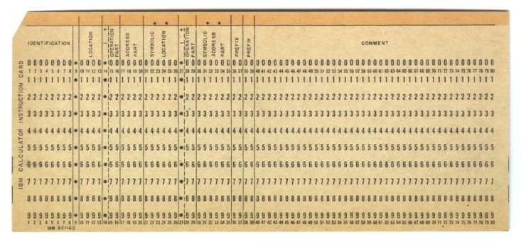
In the beginning...
Computers were originally programmed through direct input of machine code.

Slide 3
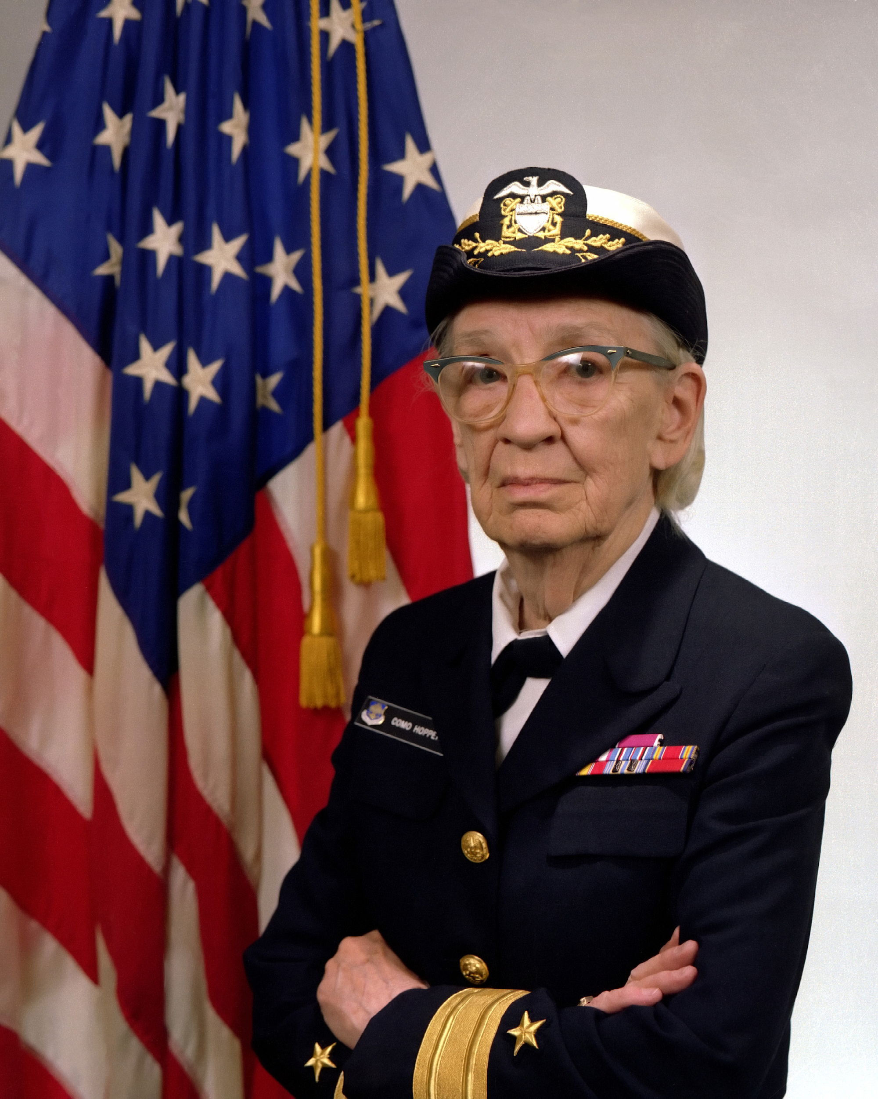
In the beginning...
In 1952, Grace Hopper proposed one the first compilers.
Problem:
early compilers created inefficient code
Problem 2:
early computers were very slow

Slide 4
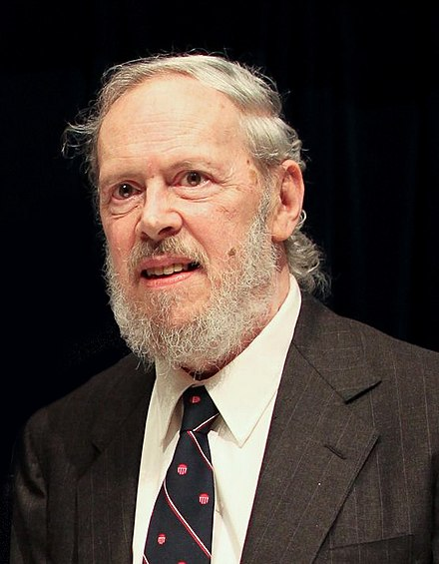
In the beginning...
In 1972, Dennis Ritchie created C.
C was specifically designed to:
by reasonably portable across computer architectures
provide developers with low-level control of memory access, etc.
In practice, C maps closely and effectively to assembly, with few runtime surprises.
With great power...

Slide 5
Since then...
A (simplified) timeline:
1970s: C is developed, maps almost directly to assembly (security implications).
1980s: Focus on features, C++ developed, compiled languages still dangerous.
1990s: Birth of modern VM-based languages. Mainstream compiled languages still dangerous.
2000s: Rise of JIT to improve VM-based/interpreted languages. Compiled languages still dangerous.
2010s: Finally exploring mainstream memory-safe compiled languages (i.e., Rust).

Slide 6
The result...
An astonishing amount of software has been developed in languages with no memory safety!
C is still the most popular programming language according to some metrics.
C++ is 4th most popular and the fastest growing!
C was the fastest growing language in terms of popularity as recently as 2017!
Why?
https://www.tiobe.com/tiobe-index

Slide 7
What's the problem with C?
Robert Graham.
"Protection in an information processing utility."
Communications of the ACM, 1968.
In 1968, we start seeing concerns
about memory corruption.
In one of the first papers proposing memory isolation between processes, Graham, et al. muse (paraphrased):
"What if a program allows someone to overwrite memory they're not supposed to?"

Slide 8
This module...
We will take a first glance several types of common "memory corruption" issues, and investigate how they can be used by attackers to circumvent system security.
Then, we'll look at some common mitigations.

